Slide 1
High-Performance and Low-Cost Array Signal Processing: Challenges and Trends in Emerging Radar Applications
Rajan Narasimha and Sandeep Rao
Texas Instruments, Inc.
April 7, 2025

Slide 2
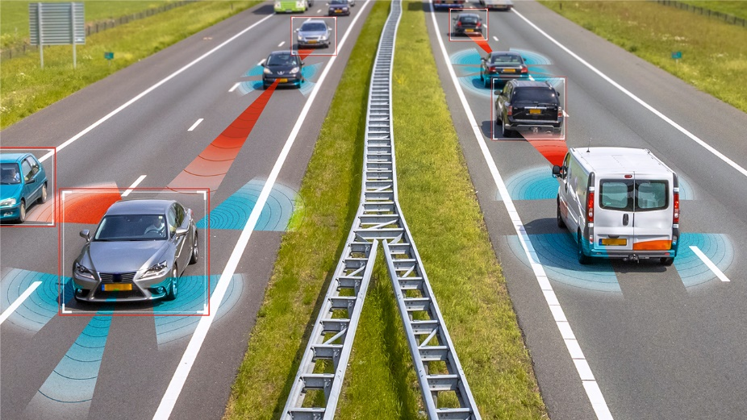
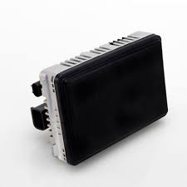
Emerging ADAS Applications: Requirements
Continental ARS540
13.7cm
9cm
Radar with LiDAR like resolution for high-res imaging
Point clouds and object detection with neural networks (e.g PointNet)
Velodyne HDL-64E LiDAR ~0.5º resolution @ 20Hz
ADAS example use case
Pedestrian automatic emergency braking [6] requires angle resolution of ≤ 0.5º deg
Key Challenges for High-Res Radar for ADAS
0.5º deg resolution azimuth and elevation
Restricted aperture and form factor: ~13cmx9cm
Dynamic scene => Single snapshot processing, ~50ms frame
Dynamic range requirements: 20 dB, imposes restrictions on side lobe levels
Multiple sources in urban environments
Image source: www.ti.com/sensors/mmwave-radar/
https://www.continental-automotive.com/en/components/radars/long-range-radars/advanced-radar-sensor-ars540.html
Notes:
Do we keep industrial
ADAS – azimuth only or azimuth and elevation
L shape antenna coming up
In cabin also can be mentioned

Slide 3
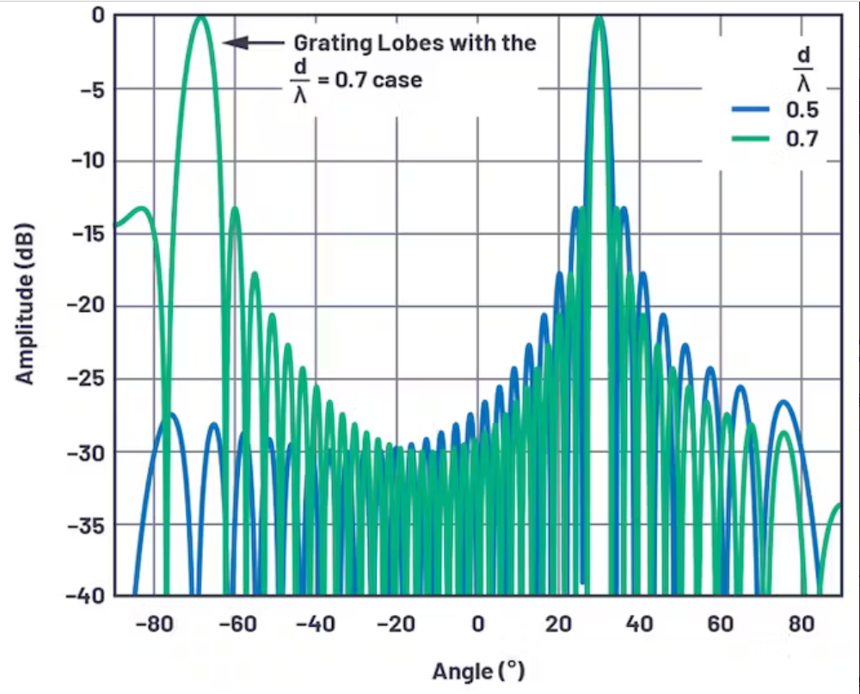
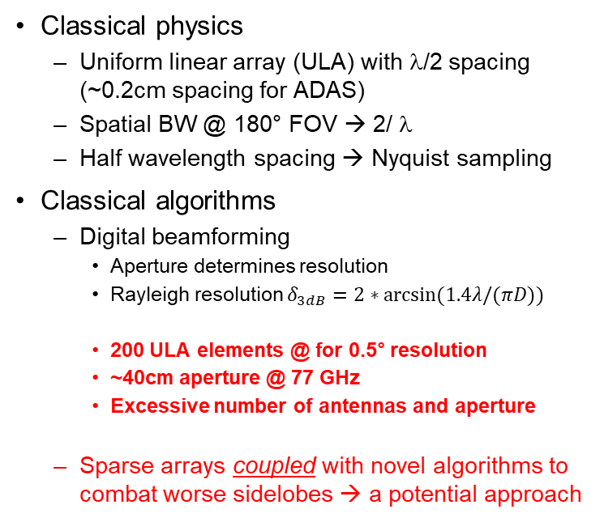
Classic Radar Processing: Limitations
Classical physics
Uniform linear array (ULA) with λ/2 spacing (~0.2cm spacing for ADAS)
Spatial BW @ 180° FOV → 2/ λ
Half wavelength spacing → Nyquist sampling
Classical algorithms
Digital beamforming
Aperture determines resolution
Rayleigh resolution $δ_{3dB}=2∗arcsin(1.4λ/(πD))$
200 ULA elements @ for 0.5° resolution
~40cm aperture @ 77 GHz
Excessive number of antennas and aperture
Sparse arrays coupled with novel algorithms to combat worse sidelobes → a potential approach
Image source: https://www.mwrf.com/
Notes:
Large to be impractical
Sparse array

Slide 4
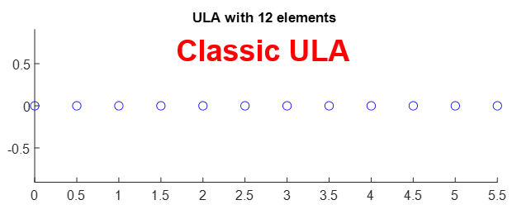
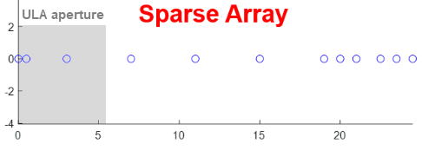
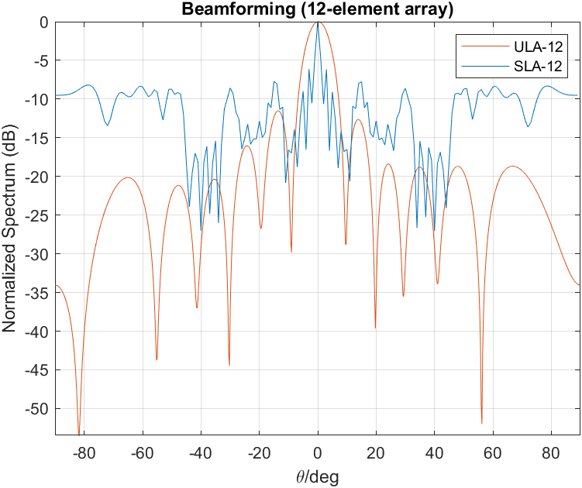
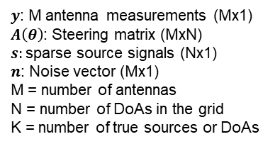
Sparse Antenna Arrays: Motivation
Dense ULA with
12 elements (ULA-12)
Sparse Array with
12 elements (SLA-12)
Sparse array has larger aperture for the same number of antennas (12) → reduced half-power beam width of main lobe for improved angular resolution/separability
Comes at the expense of side-lobes causing angular ambiguity
Need for more sophisticated algorithms to address ambiguity
λ
λ
ULA=Uniform Linear Array
Problem Statement
$y$: M antenna measurements (Mx1)
$A\left(θ\right)$: Steering matrix (MxN)
$s:$sparse source signals (Nx1)
$n$: Noise vector (Mx1)
M = number of antennas
N = number of DoAs in the grid
K = number of true sources or DoAs
Underdetermined system$y=A\left(θ\right)s+n$ with many solutions
→ Impose suitable constraints to extract a suitable solution of $S$

Slide 5
Sparse Recovery Landscape Overview
+
[2,5,17]
[20,22]
[21]
[1]
[1]
[16]
[1,4]
[1,7,9]
[3]
[11]
[19]
[13]
[8,14]
Combination of problem settings, optimization goals, approaches, analytical tractability and complexity → results in a sizeable landscape of arrays and algorithms being investigated in literature

Slide 6
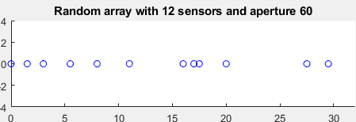
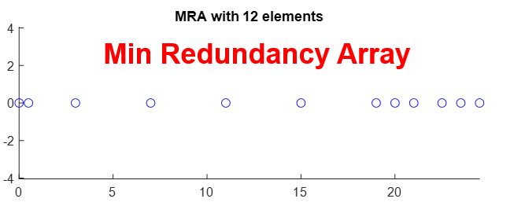
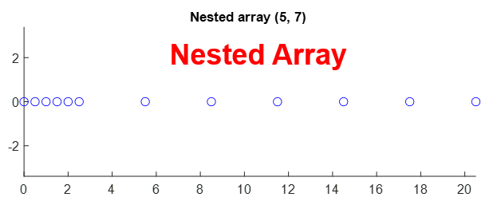
Array + Algorithm: Examples
Strong interplay between array and algorithm -> some examples
Array | Algorithm | Problem Addressed
Nested/Coprime/Min Red Array | Spatial smoothing + MUSIC | Multiple snapshot + more sources than sensors
Random | OMP, BP, SBL, SPICE… | Gridded: Single/multiple snapshot + high res
Random | NN matrix completion | Gridless: Single/multiple snapshot + high res
Random | Atomic Norm Minimization | Gridless: Single snapshot + high res
Random Array
Priors
Sparse Bayesian learning (SBL) -> Gaussian prior
Cauchy Gaussian -> Cauchy Prior
Learning priors through AI/ML -> LISTA
Hyperparameters
No hyperparameter tuning -> e.g, SPICE
Manual hyperparameter selection -> e.g, Basis Pursuit Denoising
Learn from data -> e.g, SBL
Ongoing and Future work
Improving performance under wide range of operating conditions at manageable complexity
Non integer arrays, distributed arrays
Learning based methods
Automatic model order selection and parameter optimization
H/W optimization and cost-efficient implementations
Design under constraints
Notes:
Pictures for the slides
Specify that single snapshot regime and few snapshots regime is grey area
Much of the detailed analysis is for asymptotic region where large number of snapshots are available
Univ as looking at developing the math and guarantees for a specific problem
Practically what is the number of antennas, expectation on side lobes
Maybe combine the array and algorithm slide to one slide
Show that if we do BP how does the spectrum look
Make it more intuitive – motivate array
Different arrays require different algorithms
Side lobe in the field of view example – this one has side lobe at the edge of the fov

Slide 7
High Perf. Low Cost Array Signal Processing Trends
Reduction in channel count: An Example
Efficient digital implementation: Examples
H/W Efficient Embedded Implementation: DSP + FFT Acceleration
Array and Algorithm Co-design
Spatially smoothed (SS) Music Friendly Arrays
Array Design For Emerging Antenna Technologies
Current and Future Directions
Notes:
Admm acceleration example

Slide 8
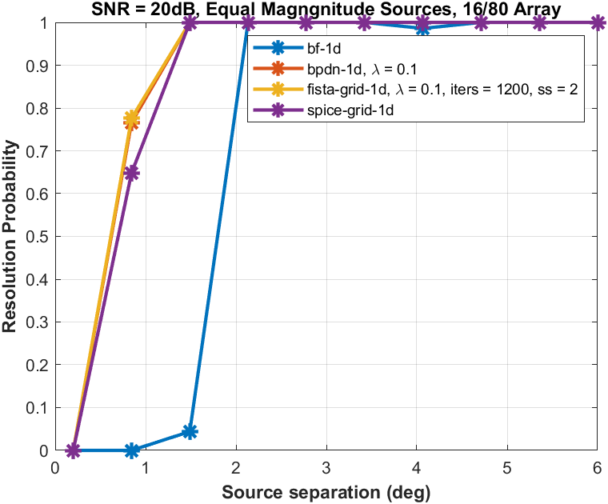
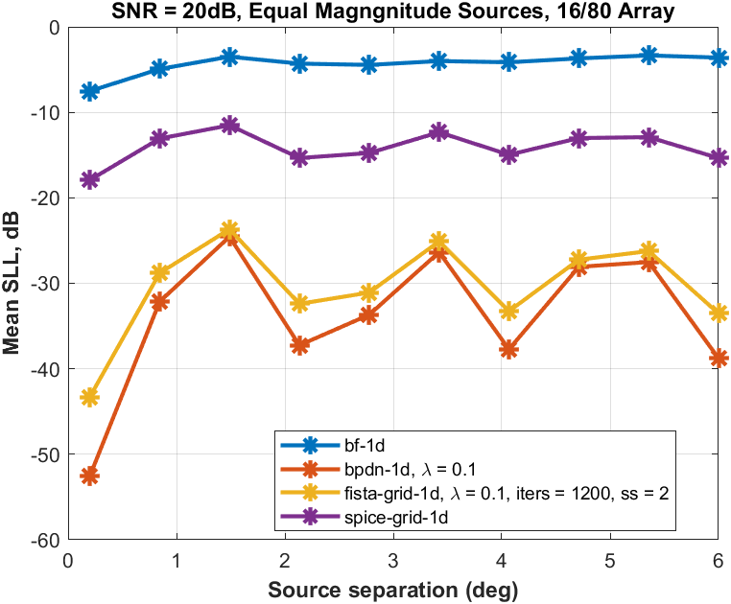
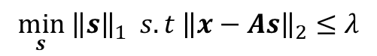
BPDN Algorithm: Performance
$$\min_{s} {\left\|s\right\|}_{1} s.t {\left\|x−As\right\|}_{2}≤λ$$
Performance Comparison for 16 over 80 sparse array
Resolution probability:
~5x improvement over Rayleigh resolution of 16-element ULA
~2x improvement over Beamforming for the 16/80 sparse array
Side lobe levels:
> 20dB reduction in side-lobe levels compared to beamforming
CS style approach: Minimize L1 norm while ensuring data fidelity
L1 norm => A convex optimization problem
Several solution approaches to solve the optimization
ISTA, FISTA, ADMM, Homotopy etc.

Slide 9
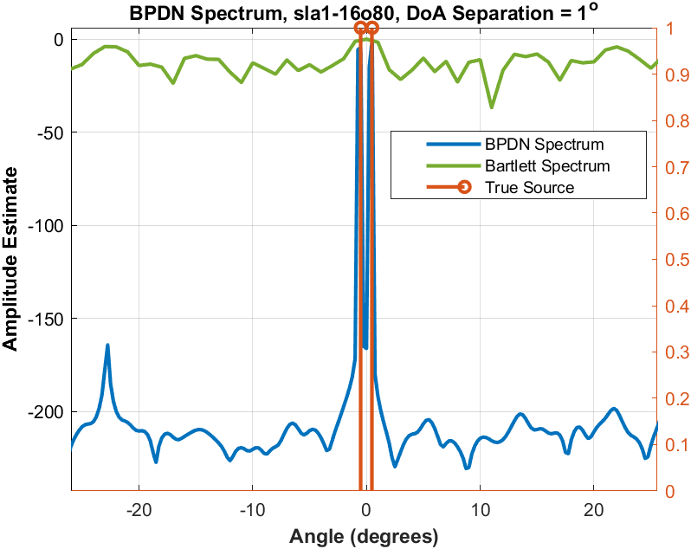
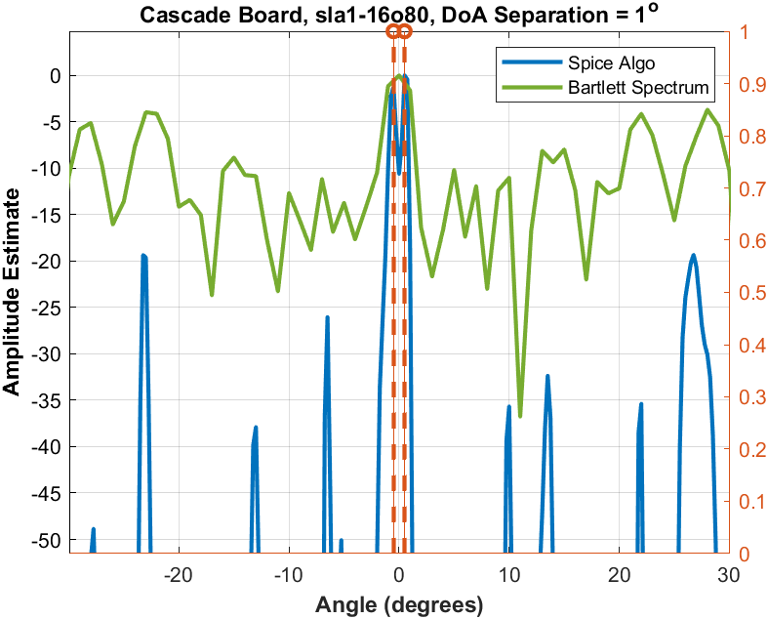
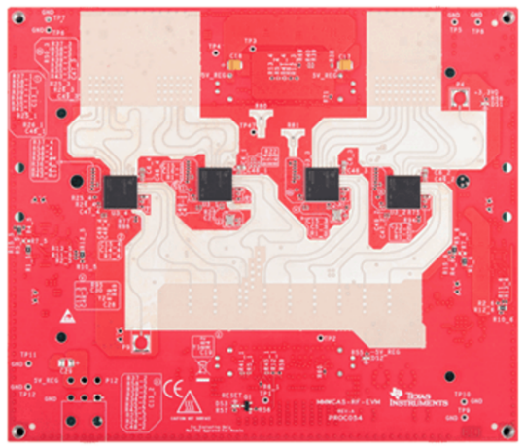
Cascade Board Data: DoA Separation = 1º
TI Cascade EVM
Data from 86 virtual elements of cascade board
4 cascaded transceivers with 3tx and 4rx each
Subsampled measurement at 16 locations with aperture 80 to emulate a random 16 over 80 array
Compared Bartlett BF with SPICE, BPDN
Performance comparison
Both sparse recovery algorithms can resolve the two corner reflectors placed at 1° separation
Side lobe levels: BPDN (-160dB) < SPICE (-20dB)
Note: BPDN has a hyper-parameter to be tuned unlike SPICE
Demonstrates performance vs complexity trade-offs
5x reduction in number of elements for an aperture of 80 elements achieved – while satisfying resolution and SLL requirements

Slide 10
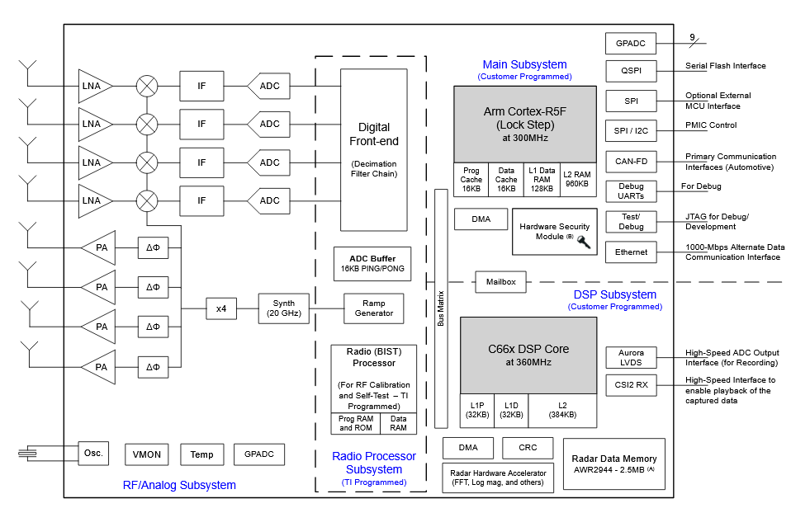
AWR2944 Functional Block Diagram
C66x DSP core
>50% allocation for higher level tasks such as tracking
Desirable to leverage h/w accelerator architecture
Radar H/W Accelerator
Efficient FFT implementations -> Map sparse-recovery algorithms that leverage FFT acceleration capability of TI SoC

Slide 11
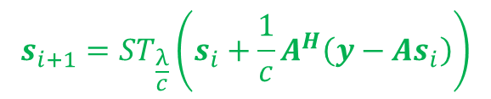
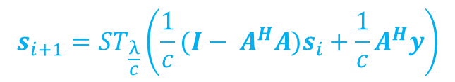
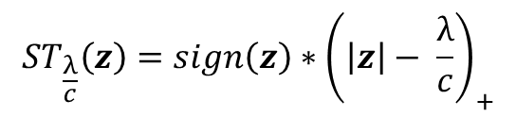
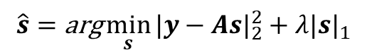
FISTA Complexity and Implementation
Complexity per iteration dominated by matrix-vector multiplication
N² + NM + N, N is grid-size and M is number of antennas
Compute model assumes second form of equation [21]
Assumption: M = 32, N = 256, 1000 iterations → 74M complex MACs per snapshot [21]
$$\hat{s}=\text{arg}\min_{s}{|y−As|_{2}^{2}+λ|s|_{1}}$$
$$s_{i+1}=ST_{\frac{λ}{c}}\left(\frac{1}{c}(I− A^{H}A)s_{i}+\frac{1}{c}A^{H}y\right)$$
$$s_{i+1}=ST_{\frac{λ}{c}}\left(s_{i}+\frac{1}{c}A^{H}\left(y−As_{i}\right)\right)$$
Complexity per iteration dominated by matrix-vector multiplication
N² MACs→ maps to N.logN FFT computation
Mapped to FFT accelerator
DSP loading decreases from 74M MACs to 8.1M MACs → 9x reduction in the above example
$$ST_{\frac{λ}{c}}\left(z\right)=sign\left(z\right)∗{\left(\left|z\right|− \frac{λ}{c}\right)}_{+}$$
Acceleration of convex optimization methods and fast algorithms for DoA estimation → key direction
[25] Yu Leiming et al, “Efficient Convex Optimization on GPUs for Embedded Model Predictive Control”, MERL Tech Report, 2017
Notes:
Refer to MERL ADMM acceleration work

Slide 12
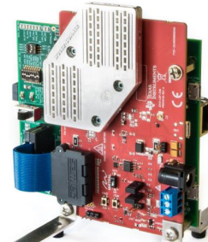
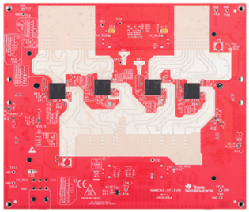
Array and Algorithm Co-Design: Spatial Smoothed MUSIC
MIMO Structure: Array patterns (1D/2D) conform to a convolution of TX and RX array
Antenna technology
Series-patch Antenna, Launch-on-package (LoP)
LoP offers 4.7dB SNR gain, insensitivity to PCB materials
Antenna dimensions and placement requirements
Super-resolution with MUSIC -> lower complexity than many sparse-recovery algorithms
Conventional MUSIC for super-resolution -> requires multiple snapshots
Single-snapshot MUSIC with Spatial Smoothing -> studied for ULA
Series Patch Antenna
LoP Antenna [1]
Not all arrays are suited for SS-MUSIC
SS-MUSIC compatible arrays
Design 2D array to facilitate 1D SS-MUSIC in azimuth dimension subject to antenna placement requirements
For applications that are azimuth-heavy
[1] 3D Waveguide Antenna Radar System: An RF Independent Substrate Solution, Garcia-Tejero et al., EUMW2022 - Automotive Forum
Notes:
Most of the literature here assumes several snapshots available -> not viable for automotive
Passive
Array design flow

Slide 13
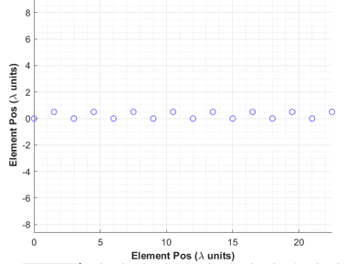
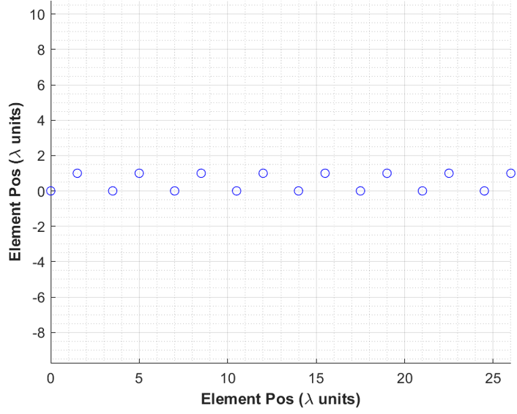
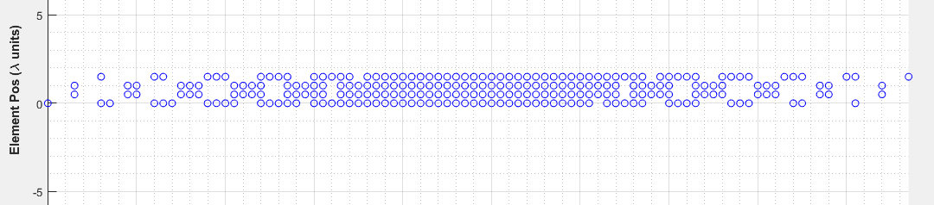
16x16 Array Design Example
TX Array
RX Array
Virtual Array
Above virtual array has max ULA length = 32 in each row
Largest contained URA size: 26x4
Facilitates SS-MUSIC over the azimuth-aperture
L-R symmetry enables FB-averaging

Slide 14
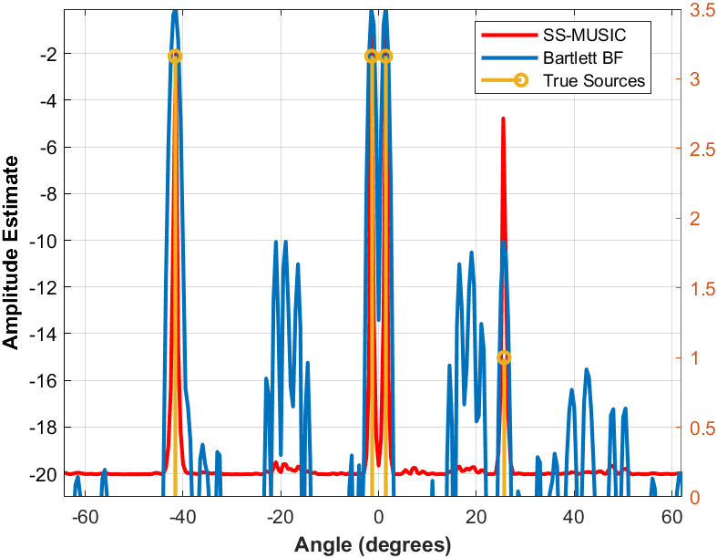
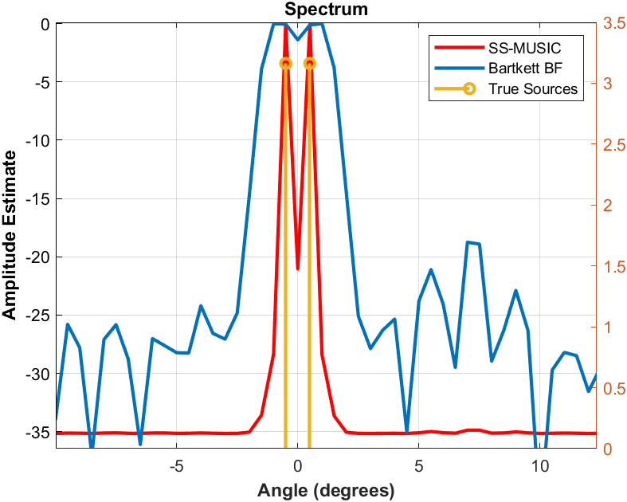
Azimuth Spectra: SS-MUSIC vs BF
10dB lower source
SS-MUSIC exhibits much lower side-lobes than Bartlett BF
Results in superior dynamic range performance
BF has multiple spurious peaks comparable in amplitude to the source at 23º
As the sources get close to each other, SS-MUSIC is able to resolve, while the BF peaks begin to merge

Slide 15
References
[14] Y Chen and Y Chie, "Robust spectral compressed sensing via structured matrix completion," IEEE Transactions in Information Theory, Vol 60, No 10, pp 6576-6601, Oct 2014
[15] P. Sarangi, M. C. Hücümenoğlu and P. Pal, "Single-Snapshot Nested Virtual Array Completion: Necessary and Sufficient Conditions," in IEEE Signal Processing Letters, vol. 29, pp. 2113-2117, 2022
[16] Ilan Ziskind and Mati Wax, "Maximum likelihood localization of multiple source by alternating projection," in IEEE Transactions on Acoustics Speech and Signal Processing, vol. 36, No. 10, pp 1553-1560, Oct 1988
[17] Yuri Abramovich et al, "Positive-definite Topelitz Completion in DoA Estimation for Non-uniform Linear Antenna Arrays - Part 1: Fully Augmentable Arrays," in IEEE Transactions on Signal Processing, vol. 46, No. 9, pp 2458-2571, Sep 1998
[18] Wenjing Liao and Albert Fannjiang , "MUSIC for Single-Snapshot Spectral Estimation: Stability and Super-resolution,” arXiv:1404.1484, Sep 2014
[19] G. Tang, B. N. Bhaskar, P. Shah and B. Recht, "Compressive sensing off the grid," 2012 50th Annual Allerton Conference on Communication, Control, and Computing (Allerton), Monticello, IL, USA, 2012, pp. 778-785.
[20] R. Fu, Y. Liu, T. Huang and Y. C. Eldar, "Structured LISTA for Multidimensional Harmonic Retrieval," in IEEE Transactions on Signal Processing, vol. 69, pp. 3459-3472, 2021
[21] J. Youn, S. Ravindran, R. Wu, J. Li and R. van Sloun, "Circular Convolutional Learned ISTA for Automotive Radar DOA Estimation," 2022 19th European Radar Conference (EuRAD), Milan, Italy, 2022, pp. 273-276
[22] V Monga, Y Li and Y Eldar, “Algorithm unrolling: Interpretable efficient deep learning for signal and image processing”, in arXiv:1912.10557
[23] H Van Trees, “Detection, estimation, and modulation theory: Part IV”, John Wiley & Sons, Incorporated, 2002
[24] I. F. Gorodnitsky and B. D. Rao, "Sparse signal reconstruction from limited data using FOCUSS: a re-weighted minimum norm algorithm," in IEEE Transactions on Signal Processing, vol. 45, no. 3, pp. 600-616, March 1997
[25] Yu Leiming et al, “Efficient Convex Optimization on GPUs for Embedded Model Predictive Control”, MERL Tech Report, 2017
[1] M. Pesavento, M. Trinh-Hoang and M. Viberg, "Three More Decades in Array Signal Processing Research: An optimization and structure exploitation perspective," in IEEE Signal Processing Magazine, vol. 40, no. 4, pp. 92-106, June 2023
[2] P. Pal and P. P. Vaidyanathan, "Nested Arrays: A Novel Approach to Array Processing with Enhanced Degrees of Freedom," in IEEE Transactions on Signal Processing, vol. 58, no. 8, pp. 4167-4181, Aug. 2010
[3] D. P. Wipf and B. D. Rao, "Sparse Bayesian learning for basis selection," in IEEE Transactions on Signal Processing, vol. 52, no. 8, pp. 2153-2164, Aug. 2004
[4] P. Stoica, P. Babu and J. Li, "SPICE: A Sparse Covariance-Based Estimation Method for Array Processing," in IEEE Transactions on Signal Processing, vol. 59, no. 2, pp. 629-638, Feb. 2011
[5] A. Moffet, "Minimum-redundancy linear arrays," in IEEE Transactions on Antennas and Propagation, vol. 16, no. 2, pp. 172-175, March 1968
[6] R Wu, “Achieving angular high dynamic range with sparse arrays," in European Microwave Week 2024
[7] Chen, Scott Saobing et al. “Atomic Decomposition by Basis Pursuit.” SIAM J. Sci. Comput. 20 (1998): 33-61.
[8] Sun and Petropulu, "A sparse linear array approach to automotive radar with matrix completion," in ICASSP 2020
[9] D. Malioutov, M. Cetin and A. S. Willsky, "A sparse signal reconstruction perspective for source localization with sensor arrays," in IEEE Transactions on Signal Processing, vol. 53, no. 8, pp. 3010-3022, Aug. 2005
[10] Candes et al., "Towards a Mathematical theory of super-resolution," in arXiv:1203.5871
[11] Li, J., Wu, R., Lu, I.-T., and Ren, D., “Bayesian Linear Regression with Cauchy Prior and its Application in Sparse MIMO Radar”, IEEE Transactions on Aerospace Electronic Systems, vol. 59, no. 6, IEEE, pp. 9576–9597, 2023
[12] Candes, Tao and Rhomberg, “Stable signal recovery from incomplete and inaccurate measurements”, arXiv 2005
[13] C. Lu, J. Tang, S. Yan and Z. Lin, "Nonconvex Nonsmooth Low Rank Minimization via Iteratively Reweighted Nuclear Norm," in IEEE Transactions on Image Processing, vol. 25, no. 2, pp. 829-839, Feb. 2016

Slide 16
Machine Learning on the Edge for low-cost mmWave Radars
Sandeep Rao, Texas Instruments
ICASSP 2025, Hyderabad

Slide 17
Introduction and Context
The previous section focused on improving the angle resolution of a mmWave radar:
Relevant for Automotive Radars (ADAS) => Larger antenna arrays and sufficient compute for complex algorithms
We’ll now look at radars at the other end of the spectrum:
Small size, low cost radars => small antenna arrays and minimal compute
Address emerging applications: Building surveillance, Occupancy sensing, Automotive incabin sensing, Elderly care, HMI
Notes:
Radar as a technology is fairly old been around since WW2 – but reason for resurgence in interest is -- smaller size, ….
TI has a family of Radar SoC’s where the …..
6843: 10mm x10mm. AoP =??
6432 : 6.5mmx6.5mm

Slide 18
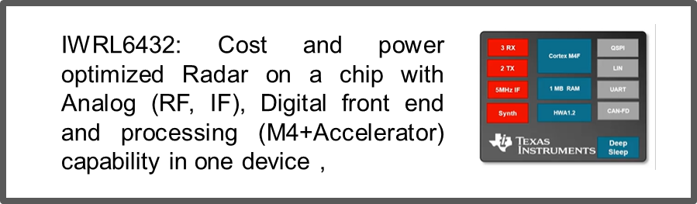
Introduction and Context
The previous section focused on improving the angle resolution of a mmWave radar:
Relevant for Automotive Radars (ADAS) => Larger antenna arrays and sufficient compute for complex algorithms
We’ll now look at radars at the other end of the spectrum:
Small size, low cost radars => small antenna arrays and minimal compute
Address emerging applications: Building surveillance, Occupancy sensing, Automotive incabin sensing, Elderly care, HMI
Notes:
Radar as a technology is fairly old been around since WW2 – but reason for resurgence in interest is -- smaller size, ….
TI has a family of Radar SoC’s where the …..
6843: 10mm x10mm. AoP =??
6432 : 6.5mmx6.5mm

Slide 19
The need for Classification
Traditional applications leverage radars strengths in target detection and tracking.
Emerging applications require target classification as well:
Segment | Use-case
Building Automation / Surveillance | Motion Classification (detect intruders while ignoring motion from pets, trees etc.)
Elderly care | Fall Detection , Activity Classification
Gesture Recognition | Mobile Devices, Household appliances, Kick-2-Open (Automotive Boot opener), Automotive Dash Board,

Slide 20
The need for Classification
Traditional applications leverage radars strengths in target detection and tracking.
Emerging applications require target classification as well:
Radar classification can leverage the work done in the context of Vision. However nature of the signal is different
Vision: high spatial resolution. None or limited range/velocity resolution
Radar: High range/velocity resolution. Limited spatial resolution
Hence intuition on feasibility, performance, and compute complexity has to be built ground up
Segment | Use-case
Building Automation / Surveillance | Motion Classification (detect intruders while ignoring motion from pets, trees etc.)
Elderly care | Fall Detection , Activity Classification
Gesture Recognition | Mobile Devices, Household appliances, Kick-2-Open (Automotive Boot opener), Automotive Dash Board,

Slide 21
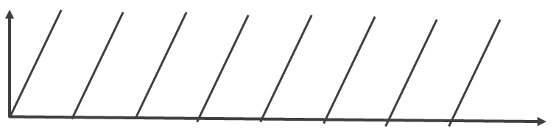
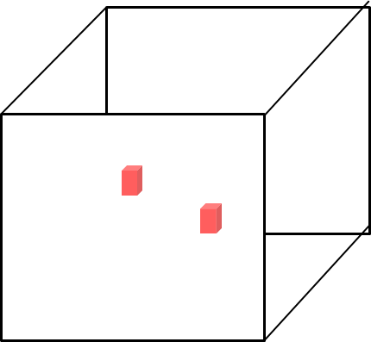


A 30sec intro to Radar Processing
f
A chirp is a signal whose frequency increases linearly with time
f
A radar transmits a series of equi-spaced chirps in a unit called a “frame”
t
t
TX signal
Radar Sensor
Signal processing resolves targets in Range, Velocity and Angle
RX signal
FFT based Signal processing
Velocity
Angle
Range
Reflections of the TX signal are received across multiple RX antennas.
Notes:
Radar Signal Processing is a vast and interesting field. But in this slide I’ve tried to summarize the 50,000 feet view of RSP, just enough to give you context for the rest of the talk,

Slide 22
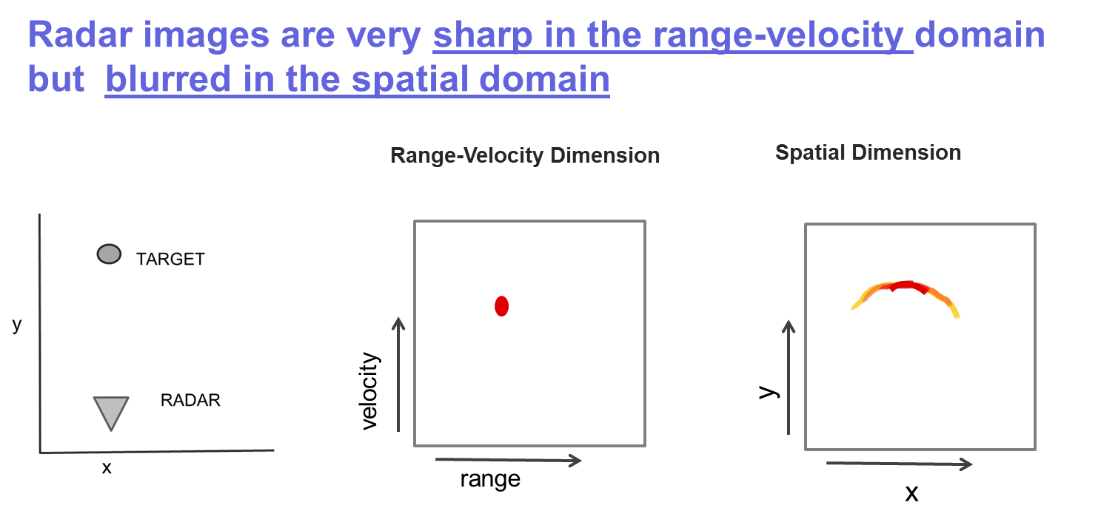
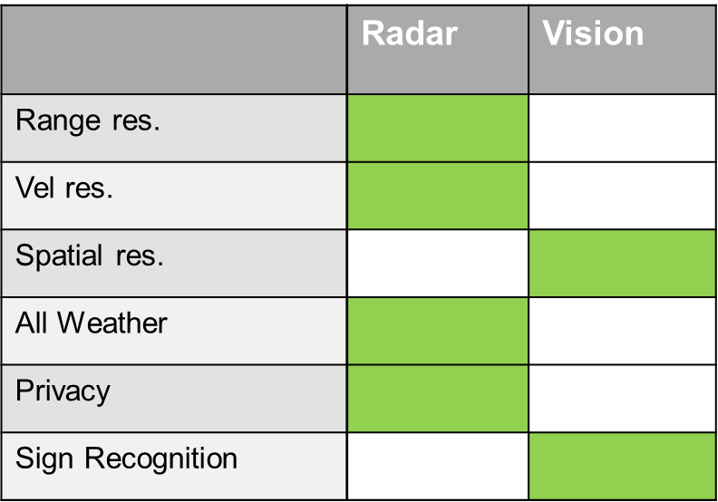
Resolution of a Radar
Radars have good range and velocity resolution but low cost radars have limited spatial resolution

Slide 23
Machine Learning on the Edge
It can be difficult to interpret radar output especially in the context of classification problems. ML is a good solution
We will discuss 2 representative examples
Gesture
Target classification

Slide 24
Gesture Recognition

Slide 25
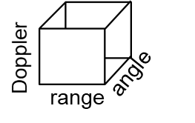
A typical Radar Signal Chain
PHY processing
Detection
Clustering & Tracking
Tracked point cloud
ADC samples
Source : Machine Learning on the Edge with mmWave Radar IWRL6432. TI application note SWRA774

Slide 26
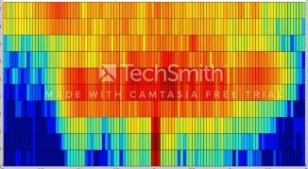
Modified for Gesture Recognition (1/2)
CNN extracts features from heatmaps
RNN extracts temporal information
PHY processing
Detection
Clustering & Tracking
ADC samples
Heat map generation
CNN
RNN
Range
Doppler
Source : Machine Learning on the Edge with mmWave Radar IWRL6432. TI application note SWRA774

Slide 27
Modified for Gesture Recognition (2/2)
Handcrafted features => lower compute
PHY processing
Detection
Clustering & Tracking
ADC samples
Heat map generation
Handcrafted
Features
ANN
Range
Doppler
Source : Machine Learning on the Edge with mmWave Radar IWRL6432. TI application note SWRA774
Notes:
Mention how angle also comes in – fuzzy but makes sense

Slide 28
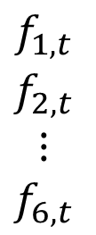
Processing using Handcrafted features (1/2)
Range-Velocity Heat map is computed for every frame t.
6 hand-crafted features are extracted from this heat map
$$\begin{matrix}\begin{aligned}f_{1,t} \\ f_{2,t}\end{aligned} \\ ⋮ \\ f_{6,t}\end{matrix}$$
Range
Doppler
Source : Machine Learning on the Edge with mmWave Radar IWRL6432. TI application note SWRA774

Slide 29
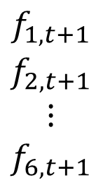
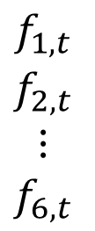
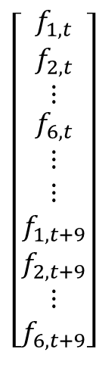
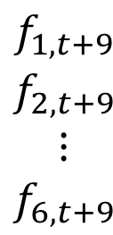
Processing using Handcrafted features (2/2)
The features across 15 consecutive frames are concatenated into a 90x1 vector
This 90x1 vector serves as input to the neural net
$$\left[\begin{aligned}\begin{matrix}f_{1,t} \\ f_{2,t} \\ ⋮\end{matrix} \\ f_{6,t} \\ ⋮ \\ ⋮ \\ f_{1,t+9} \\ f_{2,t+9} \\ ⋮ \\ f_{6,t+9}\end{aligned}\right]$$
$$\begin{matrix}\begin{aligned}f_{1,t} \\ f_{2,t}\end{aligned} \\ ⋮ \\ f_{6,t}\end{matrix}$$
$$\begin{matrix}\begin{aligned}f_{1,t+1} \\ f_{2,t+1}\end{aligned} \\ ⋮ \\ f_{6,t+1}\end{matrix}$$
$$\begin{matrix}\begin{aligned}f_{1,t+9} \\ f_{2,t+9}\end{aligned} \\ ⋮ \\ f_{6,t+9}\end{matrix}$$
Range
3 Layer ANN:
Input layer (60)
Hidden layer (150)
Output layer (7)
Doppler
Source : Machine Learning on the Edge with mmWave Radar IWRL6432. TI application note SWRA774

Slide 30
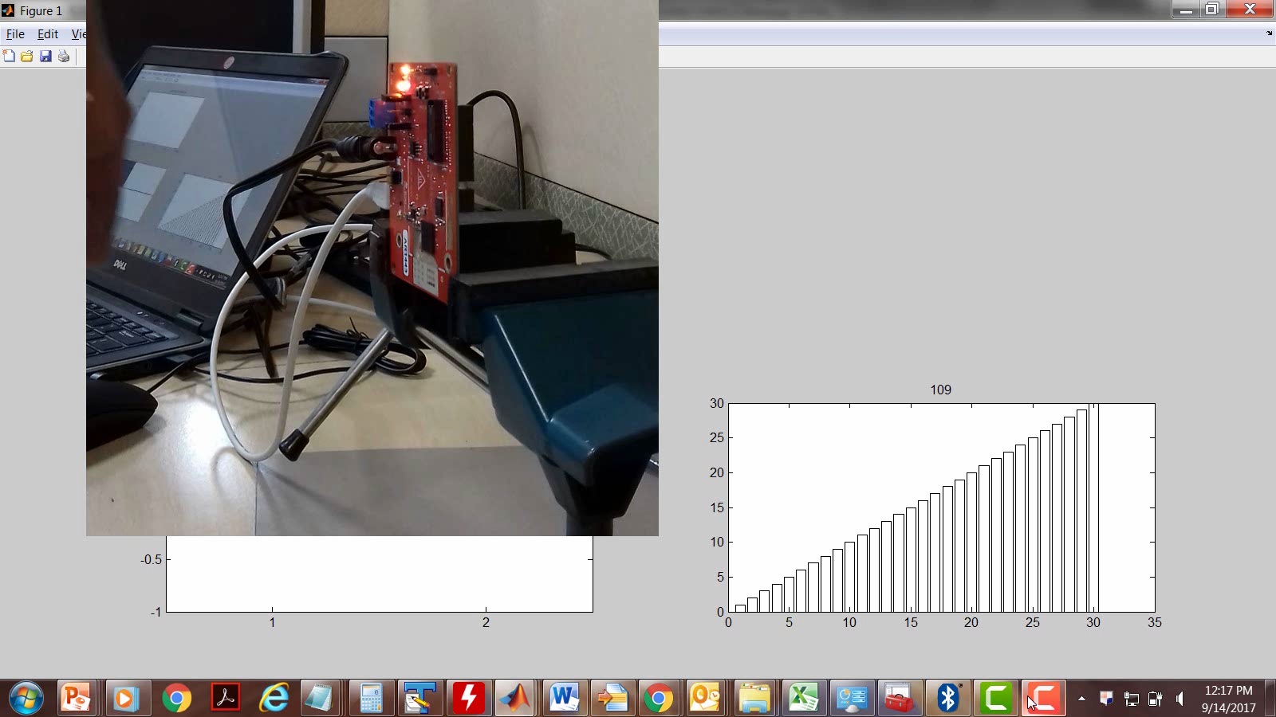
Gesture Recognition – real time example

Slide 31
Target Classification via Motion Signatures

Slide 32


Micro-Doppler Signatures
Radars natively have good Velocity resolution.
Can be used to capture the unique “velocity signature” of moving targets
Different targets (bike, pedestrian ,pet, drone, bird, car etc.) can have different “signatures”.
Can be used in target classification/ target filtering.
velocity
range
velocity
range

Slide 33
Doppler vs Time Spectrogram (1/2)
The relevant slice of the Range Velocity heat map (containing the object of interest) is identified
Doppler
Range

Slide 34
Doppler vs Time Spectrogram (2/2)
Doppler
Doppler
Time (frames)
Range
Multiple slices across time (i.e. across frames) are used to build up a ‘Velocity-Time image’
These images are sent to an appropriate classifier

Slide 35
A typical Radar Signal Chain
PHY processing
Detection
Clustering & Tracking
Tracked point cloud
ADC samples
Source : Machine Learning on the Edge with mmWave Radar IWRL6432. TI application note SWRA774

Slide 36
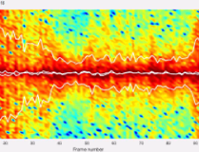
Modified for Target Classification (1/2)
PHY processing
Detection
Clustering & Tracking
Tracked point cloud
ADC samples
Spectrogram generation
CNN
Doppler
time
Source : Machine Learning on the Edge with mmWave Radar IWRL6432. TI application note SWRA774

Slide 37
Modified for Target Classification (2/2)
PHY processing
Detection
Clustering & Tracking
Tracked point cloud
ADC samples
Spectrogram generation
Feature extraction
ANN
Doppler
time
Source : Machine Learning on the Edge with mmWave Radar IWRL6432. TI application note SWRA774

Slide 38
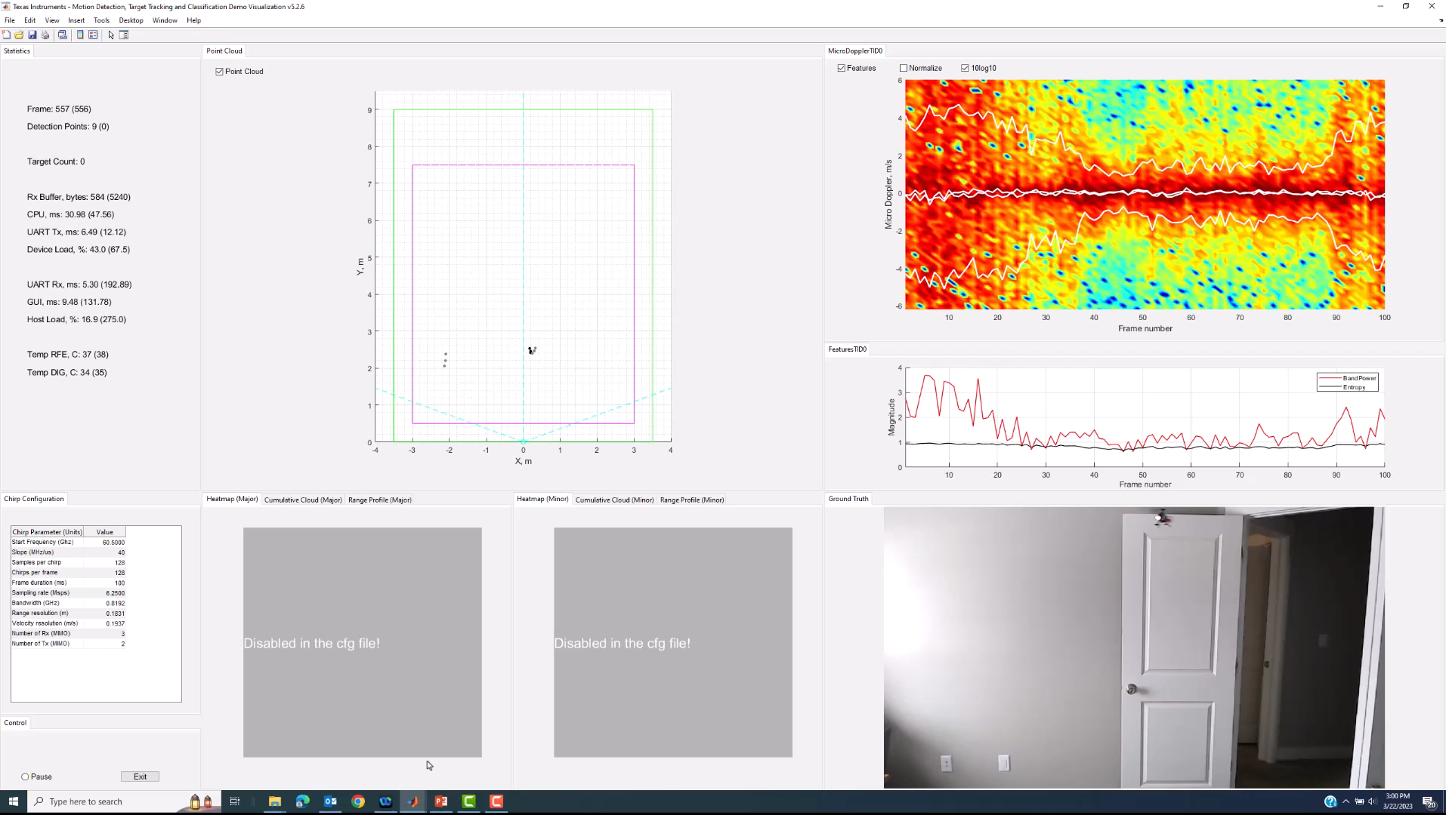
Illustrating Spectrogram signatures

Slide 39
Summary
ADC samples
PHY processing
Detection
Clustering & Tracking
Tracked point cloud

Slide 40
Summary
ADC samples
PHY processing
Detection
Clustering & Tracking
Tracked point cloud
CNN
RNN
Heat map generation
Handcrafted
Features
ANN

Slide 41
Summary
CNN
Spectrogramgeneration
Handcrafted
Features
ANN
ADC samples
PHY processing
Detection
Clustering & Tracking
Tracked point cloud
CNN
RNN
Heat map generation
Handcrafted
Features
ANN

Slide 42
Summary
CNN
Spectrogramgeneration
Handcrafted
Features
ANN
ADC samples
PHY processing
Detection
Clustering & Tracking
features
ANN
CNN
RNN
Heat map generation
Handcrafted
Features
ANN

Slide 43
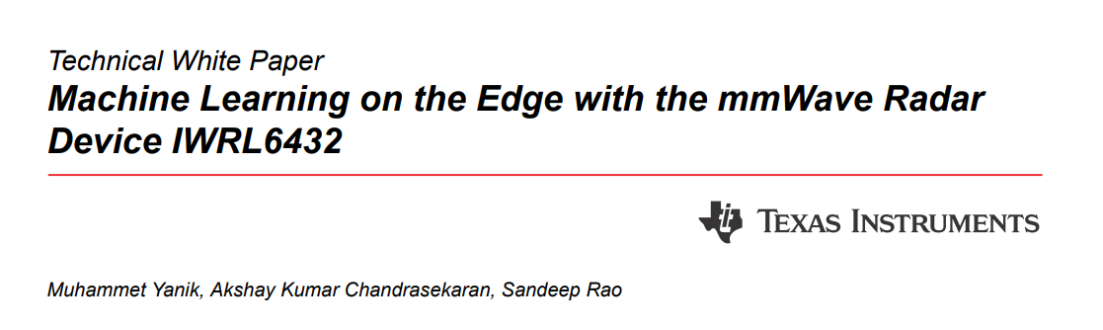

Slide 44
Back up

Slide 45
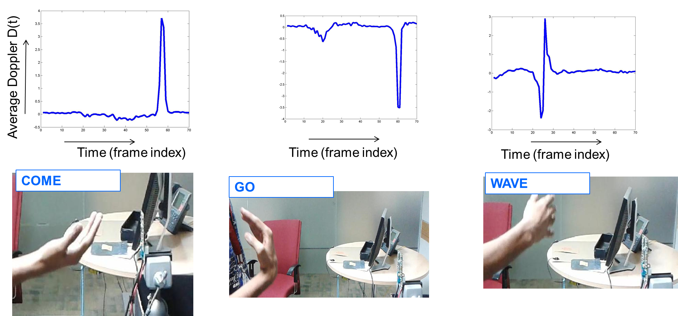
ML for mmWave Radar | How is it done?
RADAR SIGNAL CHAIN
Basic Radar PHY processing
Use-case Specific Radar Pre-processing
ML based classifier
ADC data
Classifier output
Example Signatures for Gesture Classification
Notes:
The figure shows extracted Doppler signatures which intuitively map to the corresponding actions.
Radar’s have good Doppler resolution – so many classification tasks rely heavily on Doppler based signatures.
More complex signatures can help distinguish more subtle gestures.

Slide 46
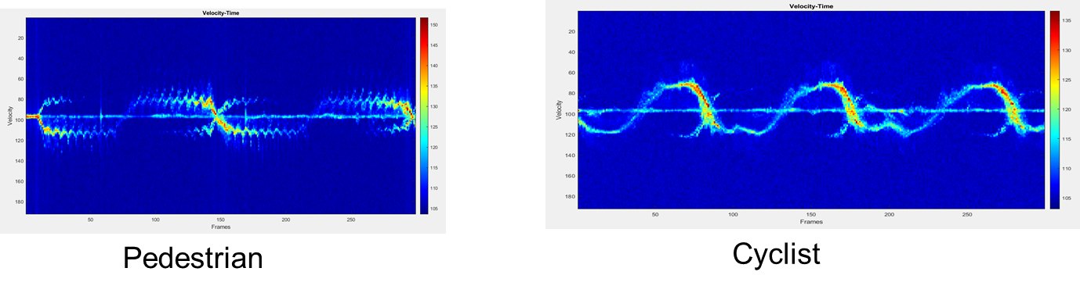
ML for mmWave Radar | How is it done?
RADAR SIGNAL CHAIN
Basic Radar PHY processing
Use-case Specific Radar Pre-processing
ML based classifier
ADC data
Classifier output
Example Signatures for Target Classification
Notes:
Here the pre-processing creates an image consisting of the time evolution of the Doppler spectrum.
(again note the reliance on Doppler – a key strength of Radar)
Typically, Moving Humans, pets, Cyclists, Fans, Drones etc tend to have unique Doppler signatures

